Slide 1
Progress Report: Kisaan Bandhu
Meet Bhanushali 1711005
Govinda Patel 1711038
Parth Sheth 1711055
Shailesh Upadhyay 1711061

Slide 2
Overview
Expected delivery
April, 2021
Recent progress
Problem Definition
Scope
Literature Survey
B.Tech Final Report
SRS Document
Methodology
Future Scope
References

Slide 3
1 - Problem Definition
Kisaan Bandhu is an application to empower the farmers by helping them reach the buyer through our application. The application will have a major role of connecting the end users via the application which will basically work as connector application for buying and selling the products which the farmers will directly put over the application for sale.Also we will implement a contract based feature wherein the farmers and the client company can have a production contract between themselves for which this application will be a mediator.

Slide 4
Motivation
Kisaan Bandhu will enable the farmer to directly reach the buyers such as bulk buyers and supermarkets hence cutting out the extra cost due the increase in the cycle due to the profit margins of the Dealers. Also the entire profit made by selling the product is received by the farmer. This application will be mainly used by farmers after crop season who need immediate sell of crops and transport to storages this system will also enable the buyers to directly place some bids on all agricultural products. Contract based deals which will be managed by our application.

Slide 5
2 - Scope
1. First of all what we will try to achieve is to remove the unnecessary cycle in between the demand supply chain.We will try to create such a system where there will be direct buyers such as supermarts or a bulk buyer where we will directly supply the production from the farmers.Our cycle will try include maximum areas of production as we will also include transport services.
2. The second task which will try to implement is to create a contract based production which will be provided by the companies. In this type what we are trying to achieve is that we will take certain contracts from the companies If the farmer decides to accept the contract then the company will provide the materials required for proper production. The company will also provide the details of the materials they will provide to the farmers for the proper production of the raw material.

Slide 6
3 - Literature Survey
For Literature Survey we have prepared a separate document.
Click here for Literature Survey.
For this document we have referred some Indian Law regarding the farmers and production allowances such as :-
THE FARMERS’ PRODUCE TRADE AND COMMERCE(PROMOTION AND FACILITATION) ORDINANCE, 2020
Role of APMCs in Agricultural Marketing in India- A Study
Farmers Suicides in India research paper
Farmer Suicides in India - Trends across Major States, 1995–2011
THE FARMERS’ PRODUCE TRADE AND COMMERCE (PROMOTION AND FACILITATION) ACT, 2020
THE FARMERS (EMPOWERMENT AND PROTECTION) AGREEMENT ON PRICE ASSURANCE AND FARM SERVICES ACT, 2020
THE AGRICULTURAL PRODUCE (GRADING AND MARKING) ACT, 1937

Slide 7
4 - SRS
For SRS Document we have prepared a separate document.
Click here for SRS Document.

Slide 8
5 – B.Tech Final Report
For Final Report we have prepared a separate document.
Click here for SRS Document.

Slide 9
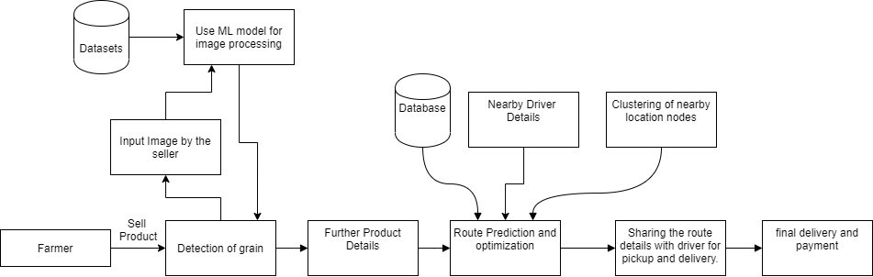
Diagrams
For different diagrams please click on the following link.
Click here for diagrams.
Architectural Diagram

Slide 10
6 – Algorithms and Techniques used
Convolution Neural Network (CNN model)
A Convolutional Neural Network (ConvNet/CNN) is a Deep Learning algorithm which can take in an input image, assign importance (learnable weights and biases) to various aspects/objects in the image and be able to differentiate one from the other. The pre-processing required in a ConvNet is much lower as compared to other classification algorithms. While in primitive methods filters are hand-engineered, with enough training, ConvNets have the ability to learn these filters/characteristics.
The architecture of a ConvNet is analogous to that of the connectivity pattern of Neurons in the Human Brain and was inspired by the organization of the Visual Cortex. Individual neurons respond to stimuli only in a restricted region of the visual field known as the Receptive Field. A collection of such fields overlap to cover the entire visual area.
We will be using CNN module for image classification during the initial selling procedure.
We will be giving an image input to our model which we have trained and the model will classify it according the type of product it is and will proceed further for filling in the other details of the product.

Slide 11
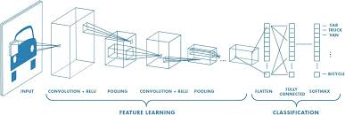
6 – Algorithms and Techniques used
Convolution Neural Network (CNN model)

Slide 12
6 – Algorithms and Techniques used
Web Scrapping
Web scraping is data scraping used for extracting data from websites. Web scraping software may access the World Wide Web directly using the Hypertext Transfer Protocol, or through a web browser. While web scraping can be done manually by a software user, the term typically refers to automated processes implemented using a bot or web crawler. It is a form of copying, in which specific data is gathered and copied from the web, typically into a central local database or spreadsheet, for later retrieval or analysis.
Web scraping a web page involves fetching it and extracting from it. Fetching is the downloading of a page (which a browser does when a user views a page). Therefore, web crawling is a main component of web scraping, to fetch pages for later processing. Once fetched, then extraction can take place. The content of a page may be parsed, searched, reformatted, its data copied into a spreadsheet, and so on. Web scrapers typically take something out of a page, to make use of it for another purpose somewhere else. An example would be to find and copy names and phone numbers, or companies and their URLs, to a list (contact scraping)

Slide 13
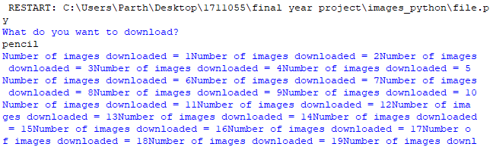
6 – Algorithms and Techniques used
Web Scrapping

Slide 14
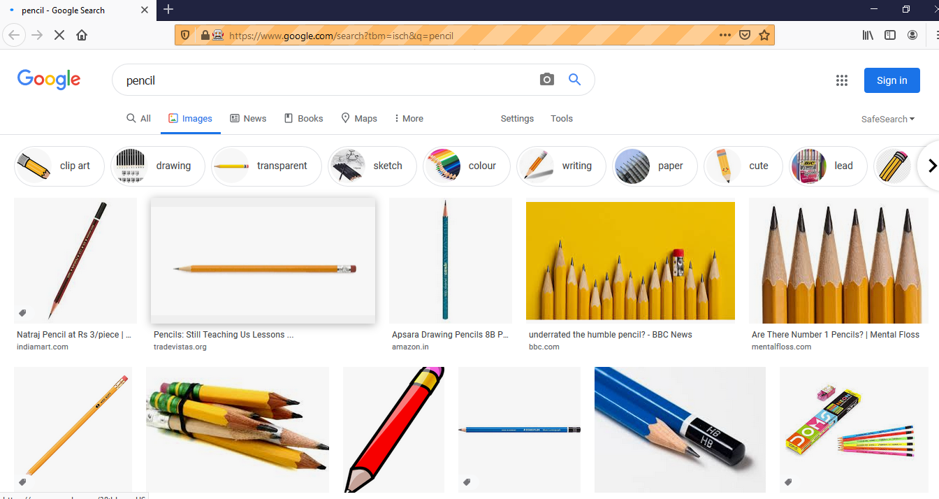
6 – Algorithms and Techniques used
Web Scrapping

Slide 15
6 – Algorithms and Techniques used
Clustering Analysis
Cluster analysis or clustering is the task of grouping a set of objects in such a way that objects in the same group (called a cluster) are more similar (in some sense) to each other than to those in other groups (clusters). It is a main task of exploratory data mining, and a common technique for statistical data analysis, used in many fields, including pattern recognition, image analysis, information retrieval, bioinformatics, data compression, computer graphics and machine learning.
Cluster analysis itself is not one specific algorithm, but the general task to be solved. It can be achieved by various algorithms that differ significantly in their understanding of what constitutes a cluster and how to efficiently find them. Popular notions of clusters include groups with small distances between cluster members, dense areas of the data space, intervals or particular statistical distributions. Clustering can therefore be formulated as a multi-objective optimization problem.
We will be using clustering for clustering the nodes which we are going to give as input to the TSP for further processing. This step is our data reduction step in which the outlier nodes are very well handled and hence we can get common nodes of pickup and delivery.

Slide 16
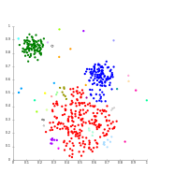
6 – Algorithms and Techniques used
Clustering Analysis

Slide 17
6 – Algorithms and Techniques used
Routing Optimization Algorithm – Travelling Salesman Problem
The travelling salesman problem (also called the traveling salesperson problem or TSP) asks the following question: "Given a list of cities and the distances between each pair of cities, what is the shortest possible route that visits each city exactly once and returns to the origin city?" It is an NP-hard problem in combinatorial optimization, important in theoretical computer science and operations research.
The travelling purchaser problem and the vehicle routing problem are both generalizations of TSP.
In the theory of computational complexity, the decision version of the TSP (where given a length L, the task is to decide whether the graph has a tour of at most L) belongs to the class of NP-complete problems. Thus, it is possible that the worst-case running time for any algorithm for the TSP increases superpolynomially (but no more than exponentially) with the number of cities.
The problem was first formulated in 1930 and is one of the most intensively studied problems in optimization. It is used as a benchmark for many optimization methods. Even though the problem is computationally difficult, many heuristics and exact algorithms are known, so that some instances with tens of thousands of cities can be solved completely and even problems with millions of cities can be approximated within a small fraction of 1%.
We’ll be using this algorithm to find the most optimised path for the transport vehicle which would include the cycle from the pickup to the final delivery of the product. This will be our main crux of the application as it will reduce the transportation cost to a great extent.

Slide 18
6 – Algorithms and Techniques used
HTTP Protocol
HTTP functions as a request–response protocol in the client–server computing model. A web browser, for example, may be the client and an application running on a computer hosting a website may be the server. The client submits an HTTP request message to the server. The server, which provides resources such as HTML files and other content, or performs other functions on behalf of the client, returns a response message to the client. The response contains completion status information about the request and may also contain requested content in its message body.
A web browser is an example of a user agent (UA). Other types of user agent include the indexing software used by search providers (web crawlers), voice browsers, mobile apps, and other software that accesses, consumes, or displays web content.
We will be using this protocol for API request handling which is a major part of our backend implementation.

Slide 19
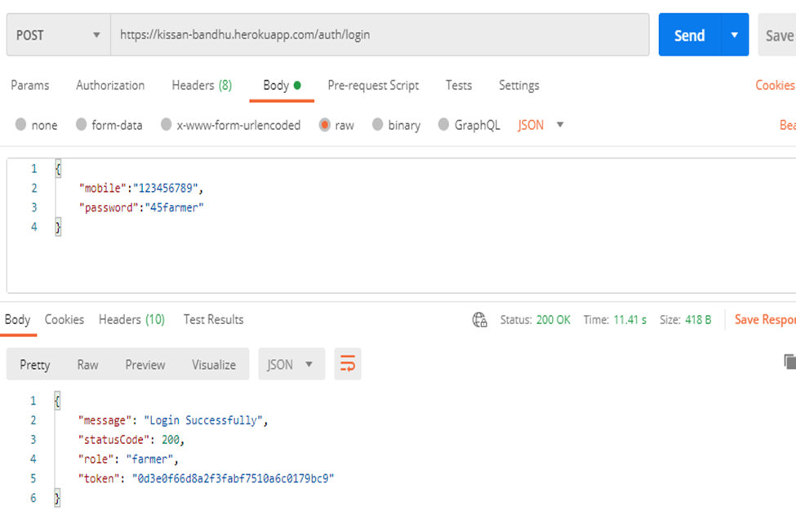
6 – Algorithms and Techniques used
HTTP Protocol

Slide 20
6 – Some of the Tools Used
Flutter
Python
API
Node.js
MongoDB
Google Maps (Geolocator)

Slide 21
7 - Methodology
Sell and Buy of the product
A. Activity 1 - Farmer posts the product on the application
Authentication of the farmer via the Login into the application.
Posting of the product on the application.
Detecting the food grain by using CNN model.
Filling the details of the product.
Final submission of the product for sale on the application.
Tracking of the application for the product in the sale cycle.
Final status of the product .

Slide 22
7 - Methodology
Sell and Buy of the product
B. Activity 2 - Transportation of the product by the Driver
Checking the availability of Driver for pickup
Assigning list of pickup locations for driver.
Deciding group of pickup location using clustering analysis based on pincode
Using Modified Travelling Salesman Problem to predict the optimised route for pickup and distribution.

Slide 23
7 - Methodology
Sell and Buy of the product
C. Activity 3 - Buying the product
Buyer places the bid for the product on the application
Using greedy approach for allotment amount of product
Accepting the payment for the product using the payment gateway.

Slide 24
7 - Methodology
2. Contract based sales
A. Activity 1 - Client
Details for the product to be grown
Quantity of the required product to be grown
Notifying farmers for the availability of a contract
B. Activity 2 - Assigning of the contract to the farmers by conditional mapping

Slide 25

8 – Completed Implementation
Geolocator – Getting the latitude and longitude of the current user.
Camera Access – Getting image of the grain for classification
DB Deployment – Multiple user by having live database.
Deployment of some API’s on Heroku
Parts of Frontend UI - Some of the UI modules of farmer is completed.
Web Scrapping – Finding images for dataset to feed into CNN model.

Slide 26
9- Future Scope
Creating a network and chain of the farmers to make efficient production cycle.
Creating a network of producers and consumers while maintaining supply chain among them.
Better transparency of transaction using Blockchain technology.
Predicting the future demand of a particular product in and hence making shift in storage of the product by utilizing the empty rounds making the transportation cycles efficient.
Predicting future demand of seasonal produces to avoid price crash in products during non demanding seasons while maintaining profitable margin.

Slide 27
10 - References
https://flutter.dev/docs
https://docs.mongodb.com/
https://expresses.com/en/5x/API.html
THE FARMERS’ PRODUCE TRADE AND COMMERCE(PROMOTION AND FACILITATION) ORDINANCE, 2020
Role of APMCs in Agricultural Marketing in India- A Study
Farmers Suicides in India research paper
Farmer Suicides in India - Trends across Major States, 1995–2011
THE FARMERS’ PRODUCE TRADE AND COMMERCE (PROMOTION AND FACILITATION) ACT, 2020
THE FARMERS (EMPOWERMENT AND PROTECTION) AGREEMENT ON PRICE ASSURANCE AND FARM SERVICES ACT, 2020
THE AGRICULTURAL PRODUCE (GRADING AND MARKING) ACT, 1937

Slide 28
Thank You

